Slide 1
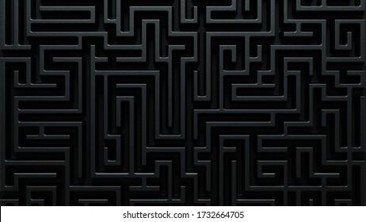
FINAL PROJECT: MAZE GAME
BY RANDY ORTIZ

Slide 2
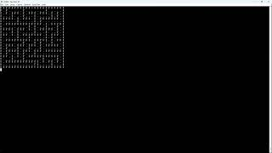
GAME WORKING:

Slide 3
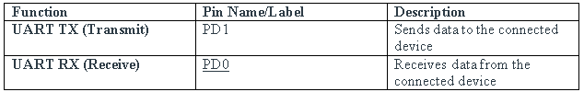
Pins

Slide 4
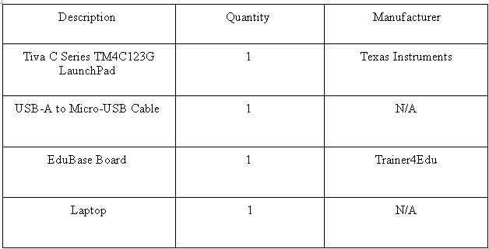
Components

Slide 5
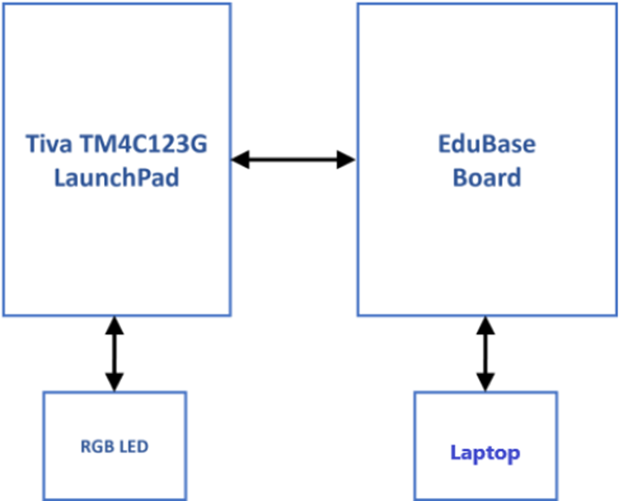
Diagram

Slide 6
MAIN PROBLEMS:
1.THE ORIGINAL PLAN WAS NOT WORKING 2. THE CODE IS NOT WORKING FOR THE SMALLER
MAZES

Slide 7
1.THE ORIGINAL PLAN WAS NOT WORKING
Recursion was not my friend or this case, what is called The Recursive Division Algorithm
So plan B was to make my own mazes through the use of maze generator and draw them out

Slide 8
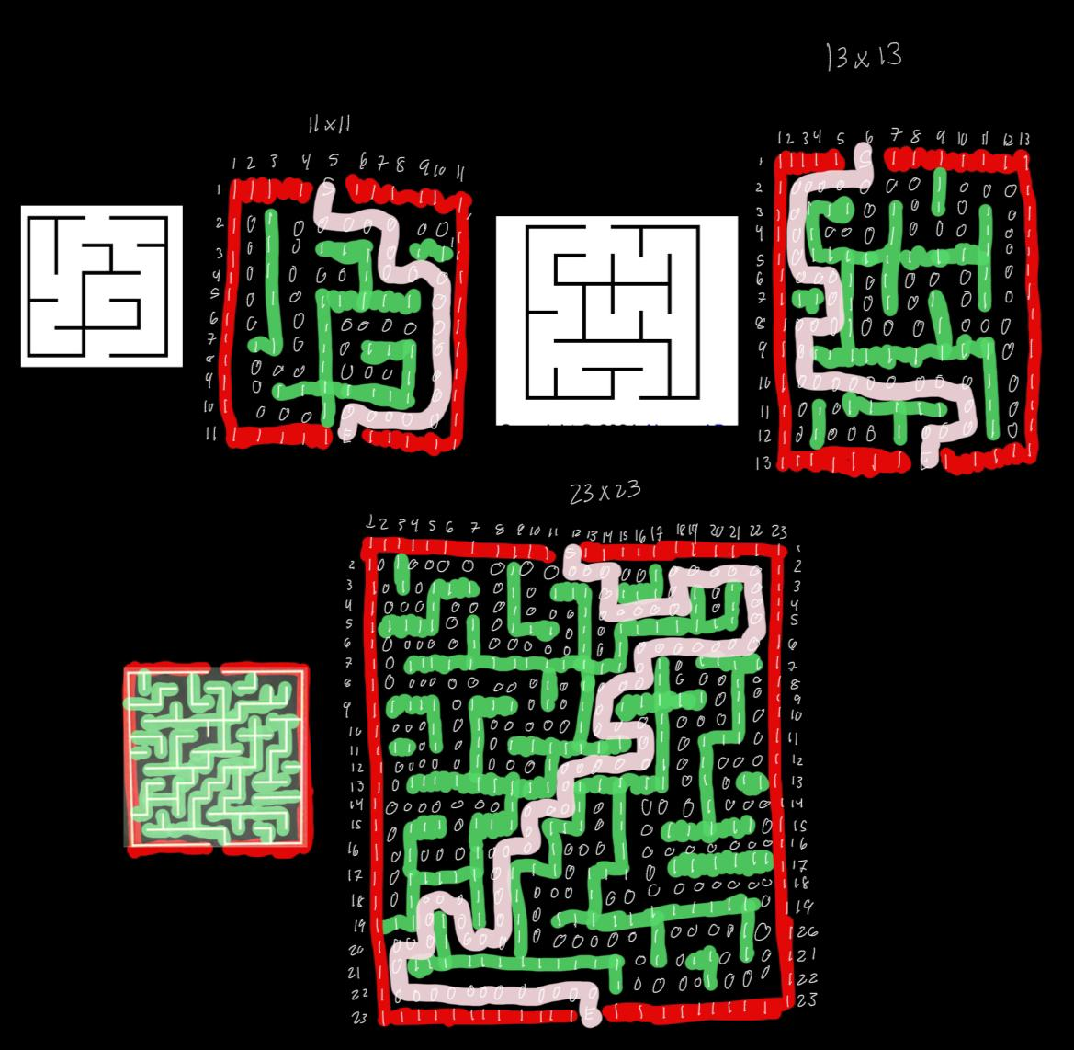
1.THE ORIGINAL PLAN WAS NOT WORKING
Recursion was not my friend or this case, what is called The Recursive Division Algorithm
So plan B was to make my own mazes through the use of maze generator and draw them out

Slide 9
1.THE ORIGINAL PLAN WAS NOT WORKING
Recursion was not my friend or this case, what is called The Recursive Division Algorithm
So plan B was to make my own mazes through the use of maze generator and draw them out

Slide 10
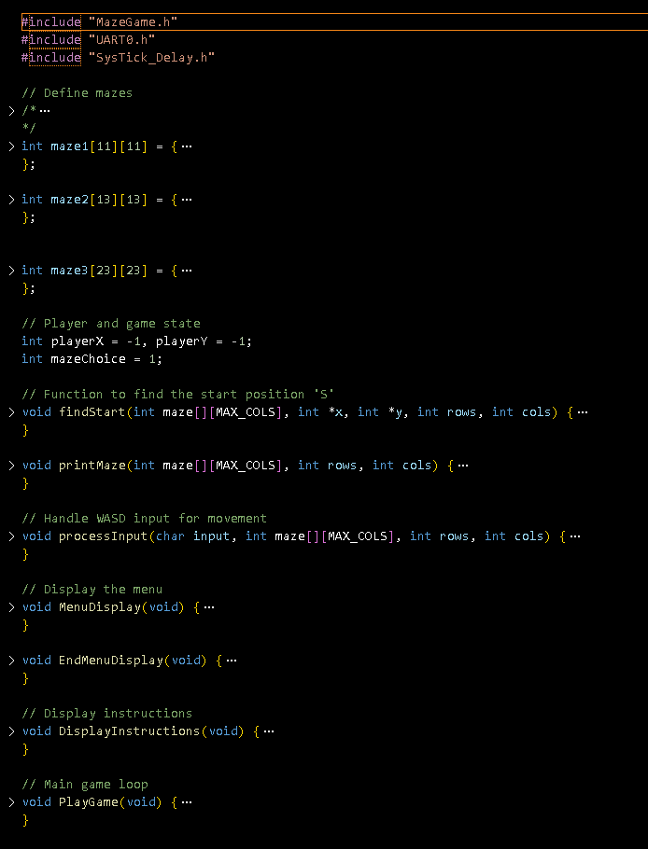
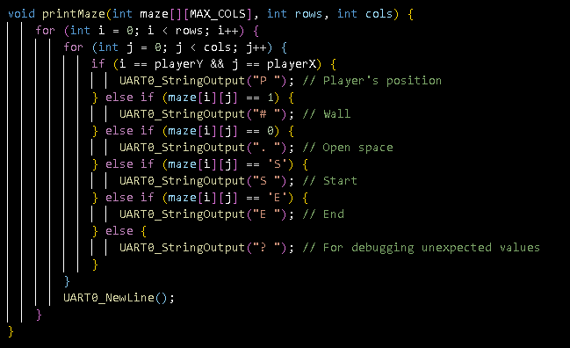
2. THE CODE

Slide 11
2. THE CODE
FINALLY THE SOLUTION:
IS HONESTLY TO JUST MAKE
2 MORE BIGGER MAZES

Slide 12
2. THE CODE
Future Works
I would like for the project to work for more mazes.
Some that are easier
Some that are harder
QUESTIONS?

Slide 13
FINALLY THE SOLUTION:
IS HONESTLY TO JUST MAKE
2 MORE BIGGER MAZES
QUESTIONS?

